Slide 1
Workforce security
Check Point’s Harmony Suite

Slide 2

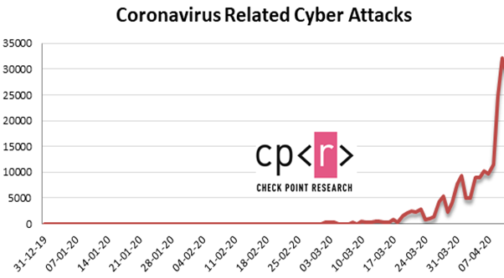

Hackers Immediately Took advantage
71% of security professionals saw increase in security threats
20,000 daily Coronavirus attacks
94% are phishing attacks
68,000 coronavirus domains registered - 50% more likely to be malicious
71% of security professionals saw increase in security threats
20,000 daily Coronavirus attacks
68,000 coronavirus domains registered - 50% more likely to be malicious
Notes:
Last year there was a cyber-siege on businesses – preying on circumstances of the time
websites with “corona”/”covid” in its domain
files with “Corona” related file names
files that have been distributed with coronavirus-related subjects in their email

Slide 3

We Helped Organizations Stay Secure During this Change
Global Courier
Shift from 8,000 to 80,000
remote access users
Financial Institution
Secure remote access for 130,000 users
Major Hospital
Quarantined doctors remotely and securely monitor Corona patients
Notes:
And Check Point – was there to help and serve the needs of our customers.

Slide 4
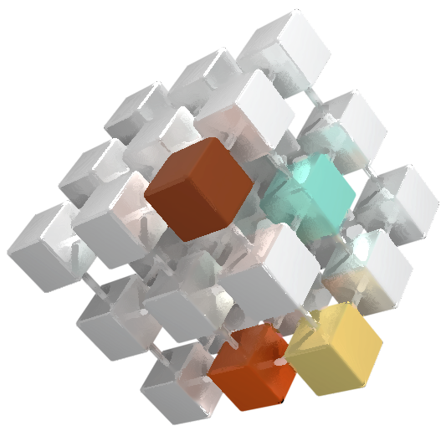
Our APPROACH
Defense in BREADTH
Providing strong security and threat
prevention across all assets
Defense in DEPTH
Providing strong security
And threat prevention
on each asset
Defense with FLUENCY
Providing strong security with speed,
accuracy and prosody
Notes:
Check Point takes a multi-dimensional approach

Slide 5

Our Strategy
THE BEST SOLUTIONS FOR CUSTOMERS’ MOST PRESSING CYBER NEEDS
1
2
3
YOUR NEEDS:
SECURITY
SIMPLICITY
INTEGRATION
OUR PRINCIPLES:
Best Prevention
GOLD Standard management
Consolidated solution
Notes:
2021 STRATEGY
Based on our customers needs we have developed 3 guiding principles
1. Deliver the best prevention
2. Ensure the Gold Standard in manageability
3. Provide consolidated solutions

Slide 6


CHECK POINT PILLARS OF INNOVATION
QUANTUM
CLOUDGUARD
HARMONY
Secure
the Network
Secure the Cloud
Secure
the Workforce
Notes:
CONSOLIDATION AROUND PILLARS

Slide 7


CHECK POINT INFINITY ARCHITECTURE
QUANTUM
CLOUDGUARD
HARMONY
Secure
the network
Secure the cloud
Secure
the workforce
Datacenter
Perimeter
Edge
IoT
Container
Workload
Visibility
Hybrid Cloud
Posture
Application
Access
Email & SasS
Browser
Mobile
End Point
Real-Time Threat Prevention
Infinity Vision
Notes:
PILLARS STAND UPON A FOUNDATION
UNIFIED THREAT PREVENTION ARCHITECTURE
CONSOLIDATED MANAGEMENT & VISIBLITY PLATFORM (XDR)
THAT COMBINED CREATE OUR INFINITY ARCHITECTURE
This year we have introduced 3 solution groups that all together accomplish our strategy of securing your everything
We call them the Pillars of innovation
But what does it mean?
If we take these solution groups we can clearly see a pattern emerging
The Quantum group is the on premise solution to security challenges
The Harmony group is the solution for those outside the perimeter wanting or needing access
And the CloudGuard group is the solution for the traditional and emerging cloud security challenges
All of these are depended on a unified system (infinity vision)that provides visibility and the ability to generate tangible information and turn it to actionable prevention with Threat Cloud

Slide 8


HARMONY
Workforce Security
Most Complete Security for your Workforce
End Point + Mobile + WEB + EMAIL+ SASE
Notes:
SO HARMONY

Slide 9
REMOTE WORK
IS NOW THE NEW WORLD
from anywhere
across any device
on any application
Notes:
OUR WORKFORCE…
The new world is being able to work from anywhere across any device on any application at anytime --- securely and effectively

Slide 10
REMOTE WORK
IS NOW THE NEW WORLD
74%
plan to enable large-scale
remote working permanently (Gartner)
Notes:
GARTNER SAYS SO
74% plan to enable large-scale
(Gartner)

Slide 11



Remote Employees are more prone to
Unintentional errors
21%
Allow family members to use their corporate devices for schoolwork, gaming, shopping, etc.

Slide 12











77%
Are using BYOD
to access corporate systems
distributed workspace
A New world of BYOD, SaaS and
multi-cloud

Slide 13



50%
increase in the daily average of ransomware attacks worldwide in Q3 2020
Compared to the first half of the year
A New challenge
Surge in sophisticated gen V attacks

Slide 14



THE CHANGING CYBER PRIORITIES
SECURING YOUR REMOTE WORKFORCE
1
RISK-BASED VULNERABILITY MANAGEMENT
2
EXTENDED DETECTION AND RESPONSE
3
CLOUD SECURITY POSTURE MANAGEMENT
4
Top 3 priorities for 2021
Top 10 security projects 2020-2021
CUSTOMER POLL
GARTNER
Notes:
YOU ARE NOT ALONE

Slide 15

THE NEW WORKFORCE DRIVERS
1
67% of breaches were the result of credential theft, social attacks or user error
– Verizon DBI report
41% of security business leaders are focused on improving
end-user experience
The workforce shifted in 2020 from 30% working remotely to over 80% working remotely
Protecting the end-user and their data from threats so they can work when they need to and from wherever they are
Improving the remote workforce experience
leads to increases in productivity
Ensuring operational resilience is dependent upon the remote workforce and cyber resilience is a key component
PROTECTION
2
PRODUCTIVITY
3
RESILIENCE
THE NEED
THE OUTCOME
Notes:
MARKET DEFINES 3 KEY DRIVERS

Slide 16


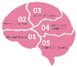
HARMONY: 360° END-USER PROTECTION AGAINST KNOWN AND ZERO-DAY THREATS
#1
Malware
Zero-days
Data leakage
Business Email
Compromise
All threats
Phishing
Ransomware
Account take-over
Bot attacks
Malicious emails
Rogue networks
Theft or Loss
USB
All vectors
Malicious websites
Rogue applications
Human Error
Managed Devices
Posture checking
ALL Devices
Unmanaged Devices
Browser
Best prevention
60+ AI & traditional security engines
The industry’s most powerful threat intelligence
Notes:
DRIVER 1 PROTECTION
KNOWN & UNKNOWN

Slide 17






HARMONY: END-USER PRODUCTIVITY MINIMIZING IMPACT AND IMPROVING PRODUCTIVITY
#2
Microsoft 365
Teams
One Drive
Enabling
COLLABORATION
G Suite
Sharepoint
Google Drive
Zero-Trust (SDP)
Clientless
Low latency
Providing USEABILITY
Content Whitening
User Education
Zero Touch Deployment
Delivering flexibility
iOS
Best prevention
60+ AI & traditional security engines
The industry’s most powerful threat intelligence
Notes:
DRIVER 2 PRODUCTIVITY
MINIMIZING IMPACT

Slide 18
HARMONY: WORKFORCE RESILIENCY HELPING BUSINESSES DELIVER THE INTENDED OUTCOME
#3
Redundancy
Zero Touch Install
Data at Rest
prepare
Connectivity
Device Profiling
Data in Motion
Adaptive Response
Behavioral Guard
Bot Protection
prevent
Leak Prevention
Threat Emulation
Content Whitening
Containment
Auto Remediation
respond
Threat Hunting
Forensic Reporting
Threat Intelligence
Best prevention
60+ AI & traditional security engines
The industry’s most powerful threat intelligence
Notes:
DRIVER 3 RESILIENCY
DELIVERING ON INTENDED OUTCOME
ADAPTING TO THE CHANGING THREATS

Slide 19





HARMONY: WORKFORCE SECURITY SUITE
Endpoint Security
Mobile Security
Browser Security
Email & Office Protection
Secure Internet & Corporate Access

Slide 20



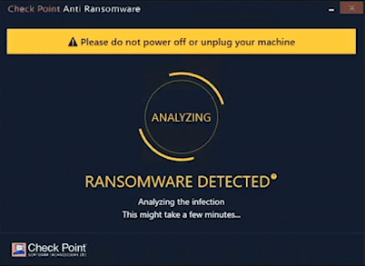

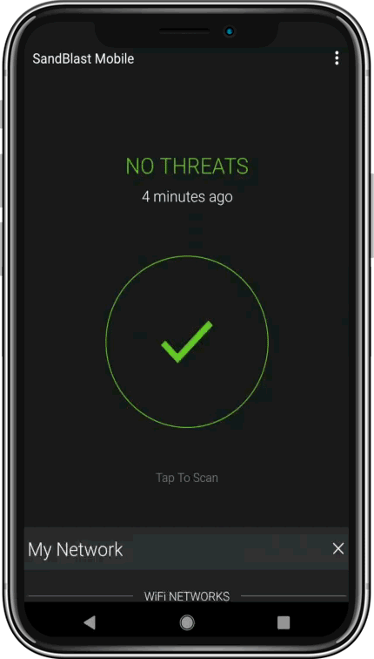
HARMONY ENDPOINT & MOBILE
PROTECT USER DEVICES
Endpoint Security
1
Reduce the attack surface
2
Prevent zero-days
3
Block ransomware
Mobile Threat Defense
1
Block Malicious Applications
2
Stop Network-based attacks
3
Real-time Device & OS risk assessment
©2021 Check Point Software Technologies Ltd.
20

Slide 21









HARMONY BROWSE
SECURE INTERNET BROWSING
Revolutionary in browser security
FAVORITE CELEBRITY WEBSITE
Download now - cool celebs.doc
Malware free files
Delivered in real-time
BLOCKED – Phishing Site
cool celebs.cleaned.pdf
Prevents malware download
Prevents phishing
Prevents corporate password exposure

Slide 22

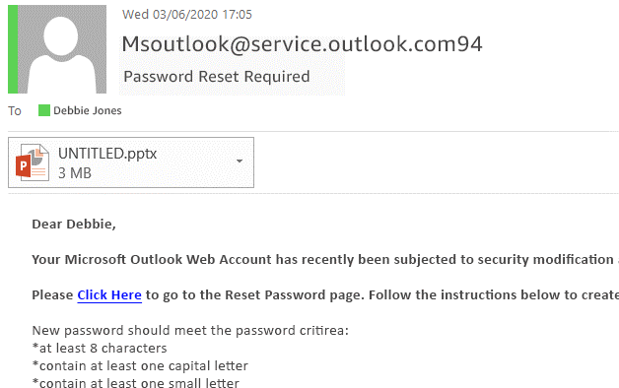






HARMONY EMAIL & OFFICE
PROTECT USER MAILBOXES & PRODUCTIVITY APPS
SUSPICIOUS SENDER
MALICIOUS ATTACHMENT
c
MALICIOUS LINK
BODY TEXT SUSPICIOUS
©2021 Check Point Software Technologies Ltd.
22
Notes:
Hybrid email environments across cloud and on prem solutions.

Slide 23


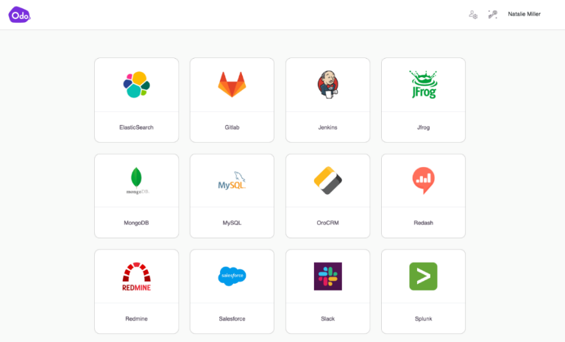
HARMONY CONNECT
SECURE ACCESS TO CORPORATE APPLICATIONS
CLIENTLESS
ZERO TRUST NETWORK ACCESS (ZTNA)
Access any application | From any device | Using a web browser
As easy as connecting to SaaS!
©2021 Check Point Software Technologies Ltd.
23
Notes:
We’ve put a huge emphasis making remote access very user-friendly.
Everything is delivered from within the browser, through a personalized and intuitive user portal to access any application with zero trust network access principles

Slide 24

HARMONIZE security for the Workforce
MOST COMPREHENSIVE LEVEL OF SECURITY
HARMONY
SIMPLE TO USE
CONSOLIDATE 6 SECURITY PRODUCTS
SIMPLE TO MANAGE
USER CENTRIC SECURITY MANAGEMENT
SIMPLE TO BUY
UNIFIED COMMERCIAL PACKAGE
Notes:
MOST COMPREHENSIVE
SIMPLE TO USE, MANAGE, BUY
Complex to secure distributed apps across clouds and datacenters.
Working from anywhere expands the attack surface
Inconsistent security policies and fragmented visibility
High overheads due to multiple point products

Slide 25

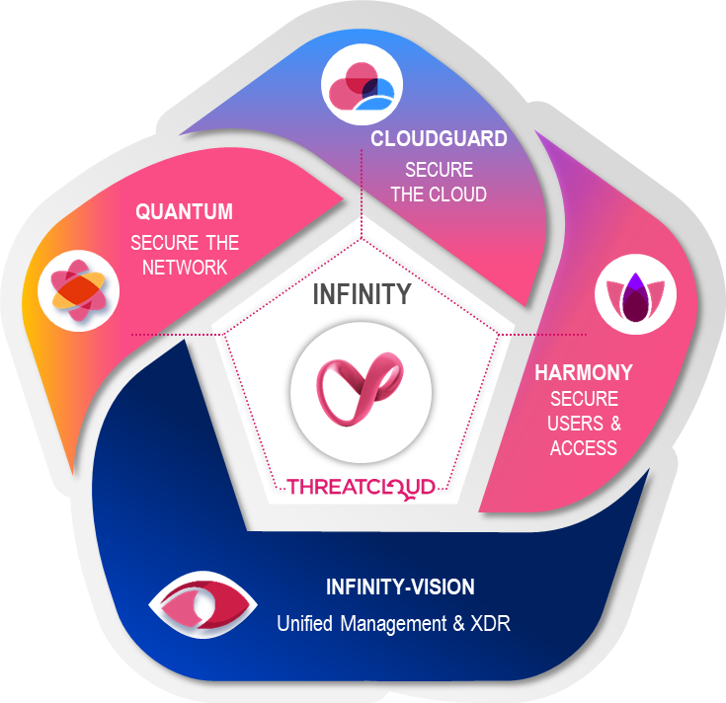
CLOUD
transformation
dynamic enforcement
flexible coverage
posture management
WORKFORCE
protection
secure access
zero trust
user aware
INFINITY
consolidation
enterprise-class
comprehensive platform
Notes:
AND IS A KEY PILLAR OF OUR INFINITY ARCHITECTURE

Slide 26
Thank You
Notes:
***STOP SHARING***
SHIFT TO RICHARD

Slide 27


CLOUD-DELIVERED SECURITY (SASE)
CONSOLIDATING 11 SECURITY SERVICES
Corporate
Email
IaaS
SaaS
Internet
1
Next Generation Firewall
2
Advanced Threat Prevention
4
SaaS API
Secure Web
Gateway
3
7
Zero Trust Network Access (SDP)
5
Data Loss Prevention
10
Device posture & compliance
8
Email Security
9
Browser protection
6
Anti-Phishing
11
Web Application & API protection
©2021 Check Point Software Technologies Ltd.
27
Notes:
As a longstanding leader in the network security space, we already have strong capabilities spanning next generation firewall, secure web gateway, advanced threat prevention, DLP, and DNS security. All of these are robust field-proven technologies, which with Harmony, we’ve adapted to the cloud. We are now delivering them as a unified service.

Slide 28
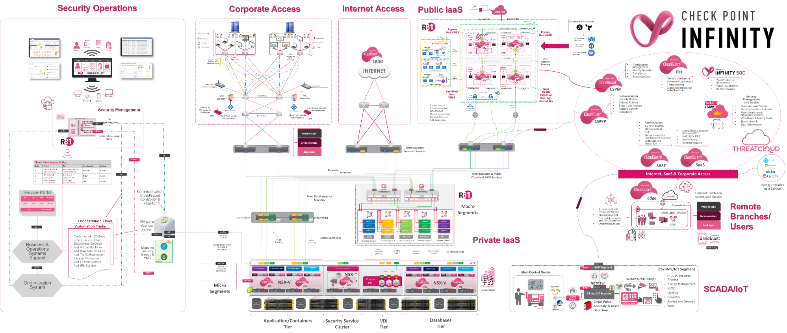


Across the enterprise

Slide 29



























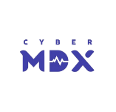











You can try and build your own security stack
NETWORK SECURITY
CLOUD SECURITY
SECURE USERS & ACCESS
NETWORK FIREWALL
CLOUD INFRASTRUCTURE
ENDPOINT SECURITY
ADVANCED THREAT PROTECTION
CLOUD WORKLOADS
MOBILE SECURITY
IOT & OT
CLOUD APPLICATION SECURITY
SASE

